Slide 1
DSL Design
A conceptual framework
for building good DSLs
Markus Voelter
independent/itemis
voelter@acm.org
www.voelter.de
voelterblog.blogspot.de
@markusvoelter
+Markus Voelter

Slide 3
Introduction

Slide 4
A DSL is a focussed, processable language for describing a specific concern when building a system in a specific domain. The abstractions and notations used are natural/suitable for the stakeholders who specify that particular concern.

Slide 5
Concepts (abstract syntax) (concrete) Syntax semantics (generators) Tools and IDE

Slide 6
 | more in GPLs | more in DSL
Domain Size | large and complex | smaller and well-defined
Designed by | guru or committee | a few engineers and domain experts
Language Size | large | small
Turing-completeness | almost always | often not
User Community | large, anonymous and widespread | small, accessible and local
In-language abstraction | sophisticated | limited
Lifespan | years to decades | months to years (driven by context)
Evolution | slow, often standardized | fast-paced
Incompatible Changes | almost impossible | feasible

Slide 7
General Purpose
C
Components
Domain Specific
State Machines
Sensor Access
LEGO Robot Control

Slide 8
Big Language
L
c
d
e
b
f
g
h
i
j
k
m
n
o
a
with many first class concepts!

Slide 9
Small Language
L
α
β
λ
ω
δ
with a few, orthogonal
and poweful concepts

Slide 10
Modular Language
my L
α
β
a
b
c
d
e
f
g
h
i
j
k
l
with many optional,
composable modules

Slide 12
Case Studies

Slide 13
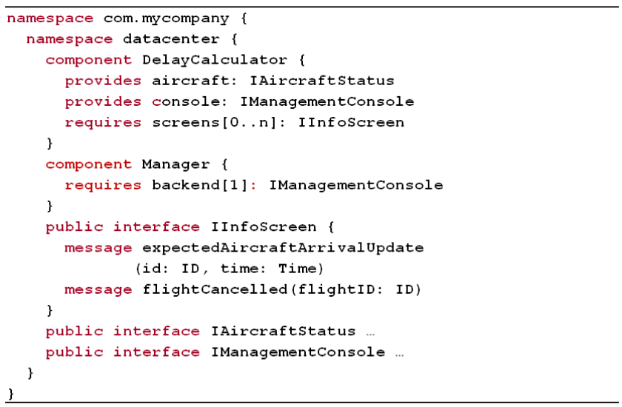
Components

Slide 14
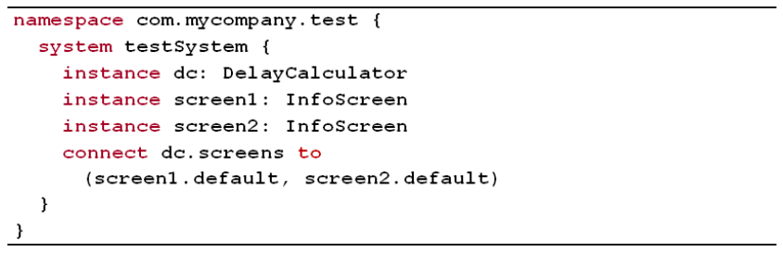
Components

Slide 15
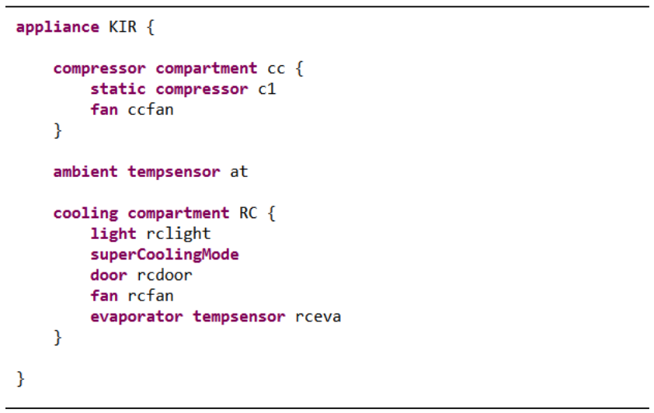
Refrigerators

Slide 16
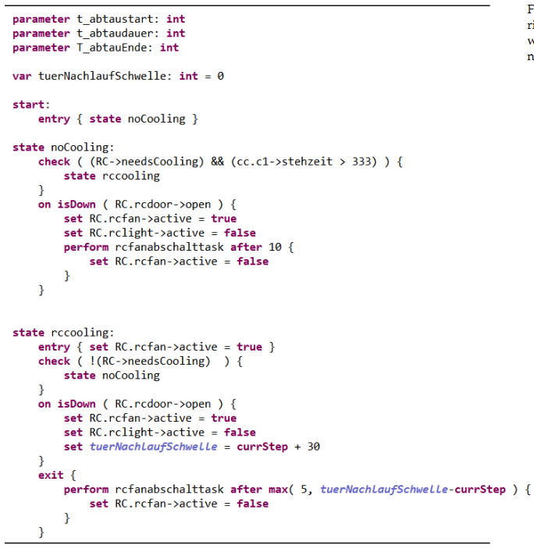
Refrigerators

Slide 17
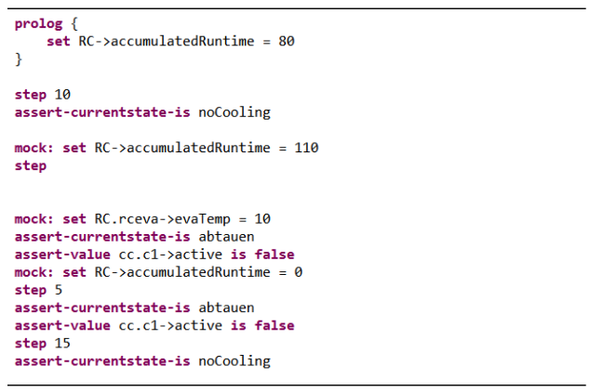
Refrigerators

Slide 18
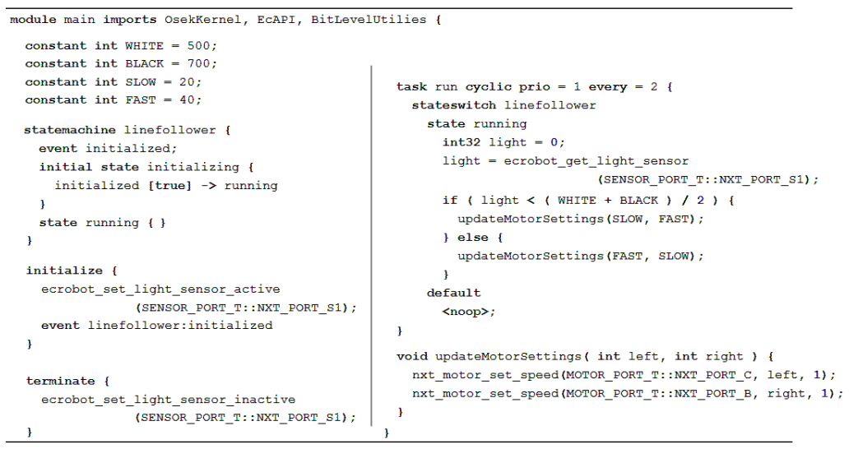
Extended C

Slide 19
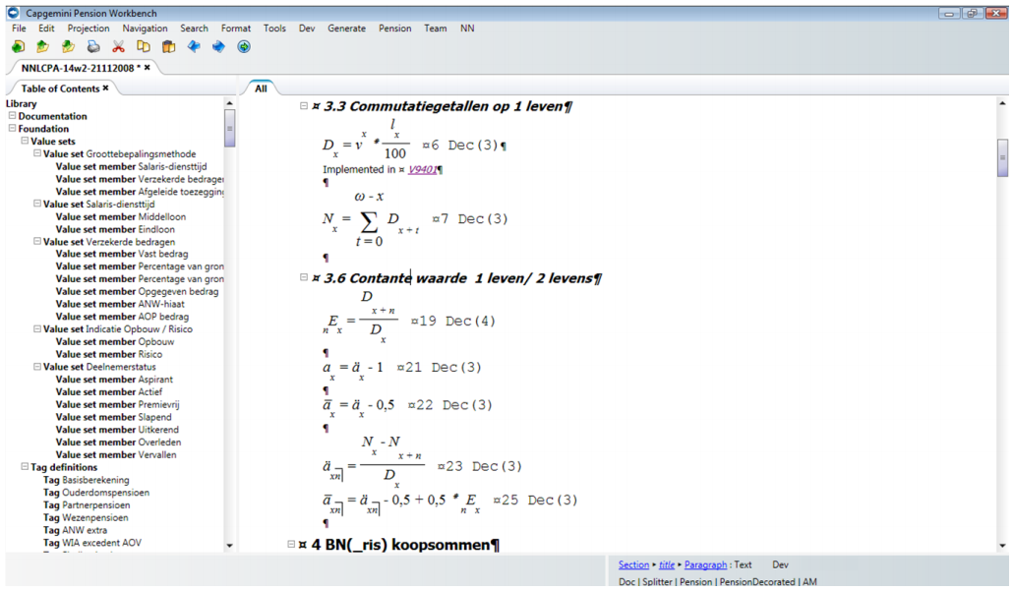
Pension Plans

Slide 20
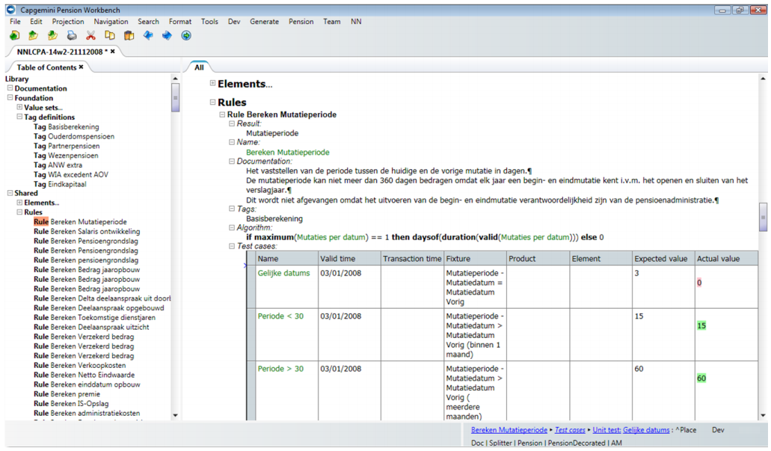
Pension Plans

Slide 21
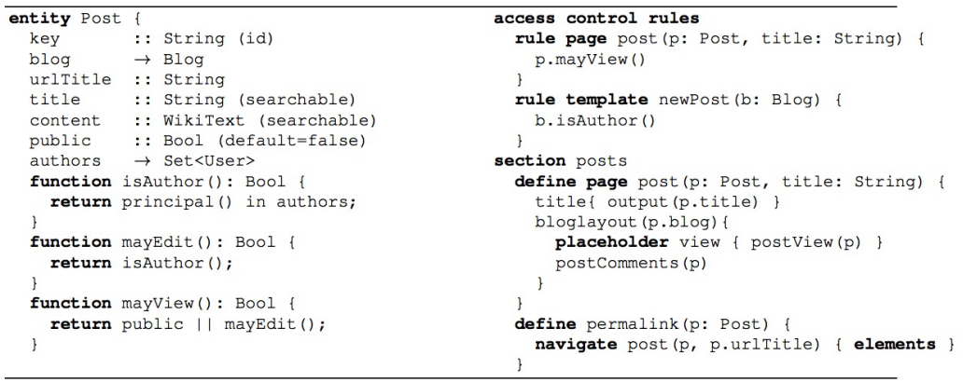
WebDSL

Slide 23
Terms & Concepts

Slide 24

Model
A schematic description of a system, theory, or phenomenon that accounts for its known or inferred properties and may be used for further study of its characteristics
www.answers.com/topic/model

Slide 25
Model
A representation of a set of components of a process, system, or subject area, generally developed for understanding, analysis, improvement, and/or replacement of the process
www.ichnet.org/glossary.htm

Slide 26
Model
an abstraction or simplification of reality
ecosurvey.gmu.edu/glossary.htm

Slide 27
Model
which ones?
an abstraction or simplification of reality
what should we leave out?
ecosurvey.gmu.edu/glossary.htm

Slide 28
Model Purpose
… code generation
… analysis and checking
… platform independence
… stakeholder integration
…
drives design of
language!

Slide 29
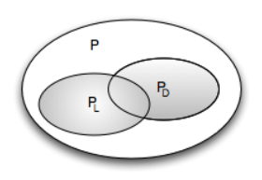
Programs Languages Domains

Slide 30
Domain
body of knowledge
in the real world
deductive
top down
inductive
bottom up
existing software (family)

Slide 31
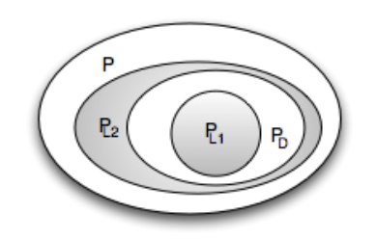
A DSL L_{D} for D is a language that is specialized to en-coding P_{D} programs.
more efficient
smaller

Slide 32
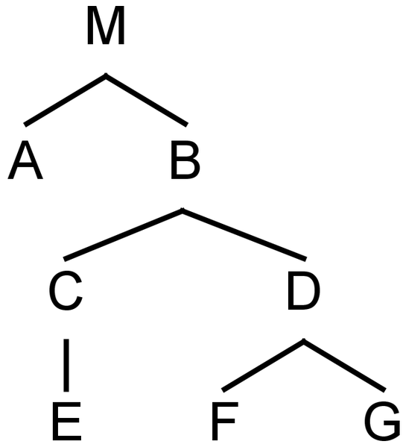
Programs are trees
element

Slide 33
Fragments are subtrees w/ root
fragment root
f
fragment

Slide 34
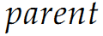
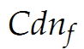
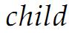
Parent-Child Relation
f

Slide 35
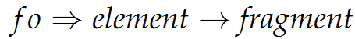
Programs and Fragments
f

Slide 36
Programs are graphs, really.
reference

Slide 37
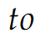
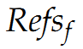
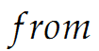
Programs are graphs, really.

Slide 38
Languages are sets of concepts
C₂
C₁
C_{n}
C₃
L

Slide 39
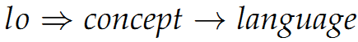
Languages are sets of concepts
C₂
C₁
C_{n}
C₃
L

Slide 40
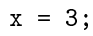
Programs and languages
C₂
C₁
C_{n}
C₃

Slide 41
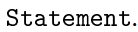
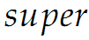
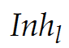
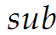
Language: concept inheritance
C₂
C₁
L₁
C₃
L₂
C₁

Slide 42
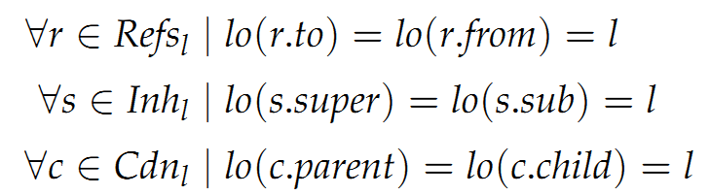
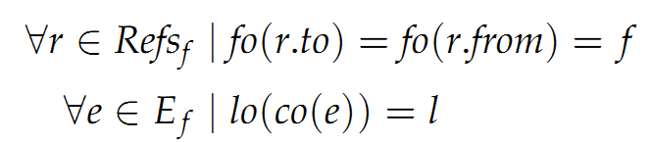
Independence
Language
does not depend on any other language
Fragment
does not depend on any other fragment

Slide 43
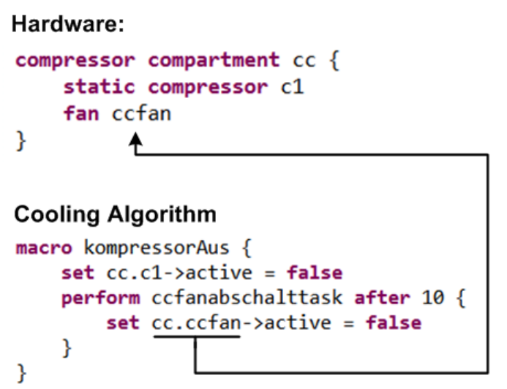
Independence

Slide 44
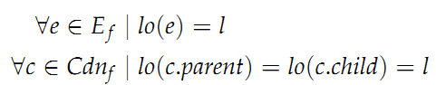
Homogeneous
Fragment
everything expressed with one language

Slide 45
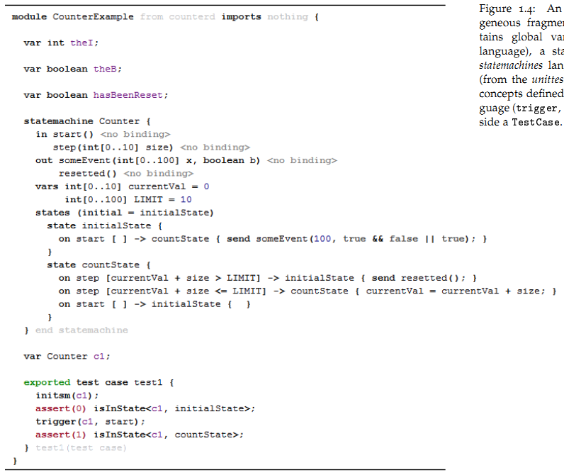
Heterogeneous

Slide 46
Heterogeneous
C
Statemachines
Testing
Heterogeneous

Slide 47
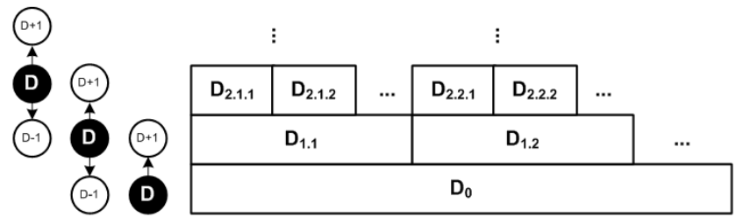
Domain Hierarchy

Slide 48
Domain Hierarchy
avionics
automotive
embedded
software
all programs

Slide 50
Design Dimensions
expressivity
coverage
semantics
separation of concerns
completeness
paradigms
modularity
concrete syntax
process

Slide 51
Expressivity
expressivity
coverage
semantics
separation of concerns
completeness
paradigms
modularity
concrete syntax
process

Slide 52
Shorter Programs
More Accessible Semantics

Slide 53
For a limited
Domain!
Domain Knowledge encapsulated in language

Slide 54
Def: Expressivity

Slide 55
Smaller Domain
More Specialized Language
Shorter Programs

Slide 56
The do-what-I-want language
Ѱ

Slide 57
Single Program vs. Class/Domain
No Variability!
Ѱ

Slide 58
Domain Hierarchy
more specialized domains
more specialized languages

Slide 59
Reification
D_{n}

Slide 60
Reification
D_{n+1}
==
D_{n}

Slide 61
Reification
Transformation/ Generation
==
Language
Definition

Slide 62
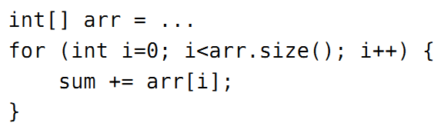
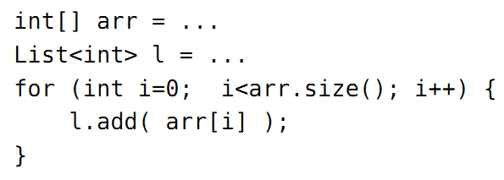
?

Slide 63
?
Overspecification!
Requires Semantic Analysis!

Slide 64
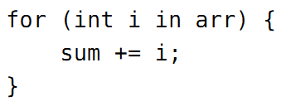
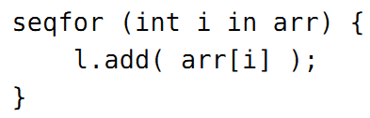
!
Linguistic Abstraction
Declarative!
Directly represents Semantics.

Slide 65
Def: DSL
A DSL is a language at D that provides linguistic abstractions for common patterns and idioms of a language at D-1 when used within the domain D.

Slide 66
Def: DSL cont’d
A good DSL does not require the use of patterns and idioms to express semantically interesting concepts in D.
Processing tools do not have to do “semantic recovery” on D programs.
Declarative!

Slide 67
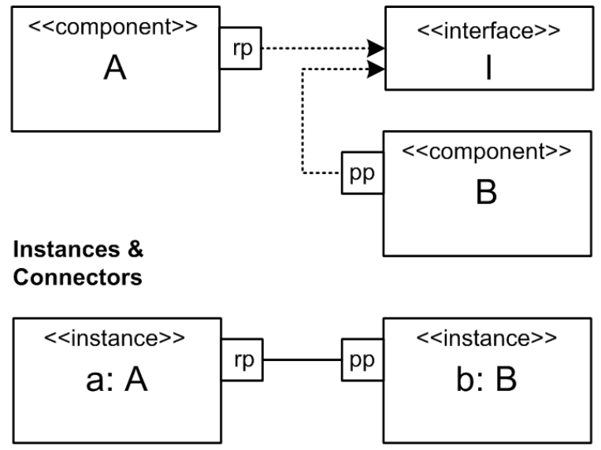
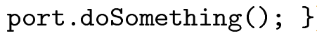
Another Example

Slide 68
Another Example
Turing Complete!
Requires Semantic Analysis!

Slide 69
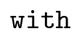
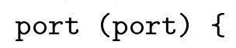
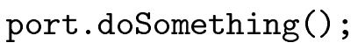
Linguistic Abstraction

Slide 70
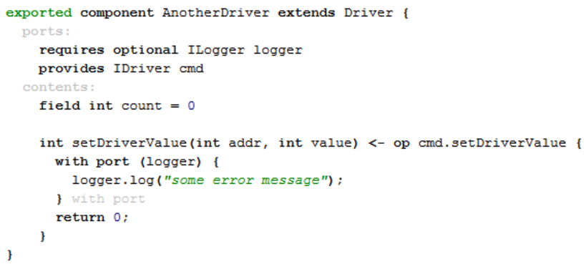
Linguistic Abstraction

Slide 71
Linguistic Abstraction
In-Language
Abstraction
Libraries
Classes
Frameworks

Slide 72
Linguistic Abstraction
Analyzable
Better IDE Support
In-Language
Abstraction
User-Definable
Simpler Language

Slide 73
Linguistic Abstraction
Special
Treatment!
Analyzable
Better IDE Support
In-Language
Abstraction
User-Definable
Simpler Language

Slide 74
Std Lib
Linguistic Abstraction
In-Language
Abstraction

Slide 75
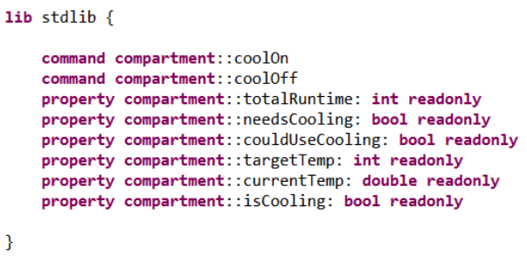
Std Lib

Slide 76
Language Evolution Support

Slide 77
Customization
vs.
Configuration

Slide 78
Precision
vs.
Algorithmics

Slide 80
Coverage
expressivity
coverage
semantics
separation of concerns
completeness
paradigms
modularity
concrete syntax
process

Slide 81
Domain D_{L} defined inductively by L
(the domain that can be expressed by L)
C_{L}(L) == 1 (by definition)
not very interesting!

Slide 82
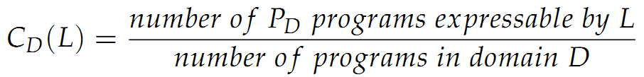
Def: Coverage
to what extend can a language L cover a domain D

Slide 83
Def: Coverage
why would C_{D}(L) be != 1?
1) L is deficient
2) L is intended to cover only a subset of D,
corner cases may make L
too complex
Rest must be expressed in D₋₁

Slide 85
Semantics & Execution
expressivity
coverage
semantics
separation of concerns
completeness
paradigms
modularity
concrete syntax
process

Slide 86
Static Semantics
Execution Semantics

Slide 87
Static Semantics
Execution Semantics

Slide 88
Static Semantics
Constraints
Type Systems

Slide 89
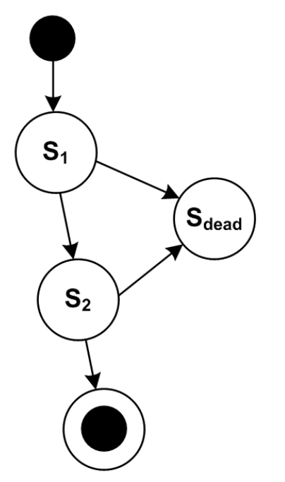
Unique State Names
Unreachable States
Dead End States
…

Slide 90
Unique State Names
Unreachable States
Dead End States
…
Easier to do on a declarative Level!

Slide 91
Unique State Names
Unreachable States
Dead End States
…
Easier to do on a declarative Level!
Thinking of all constraints is a coverage problem!

Slide 92
Assign fixed types
What does a type system do?

Slide 93
Assign fixed types
Derive Types
What does a type system do?

Slide 94
Assign fixed types
Derive Types
Calculate Common Types
What does a type system do?

Slide 95
Assign fixed types
Derive Types
Calculate Common Types
Check Type Consistency
What does a type system do?

Slide 96
Derive
Intent +
Check
More code
More convenient
Better error messages
More complex checkers
Better Performance
Harder to understand for users

Slide 97
What does it all mean?
Execution Semantics

Slide 98
Def: Semantics
… via mapping to lower level
OB: Observable Behaviour (Test Cases)

Slide 99
Def: Semantics
… via mapping to lower level
L_{D}
Transformation
Interpretation
L_{D-1}

Slide 100

Transformation
D_{n+1}
D_{n}

Slide 101
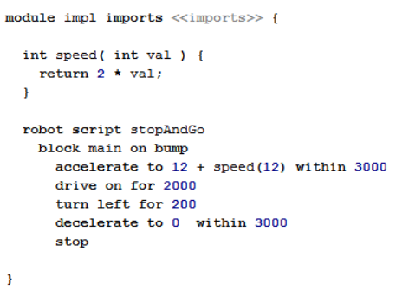
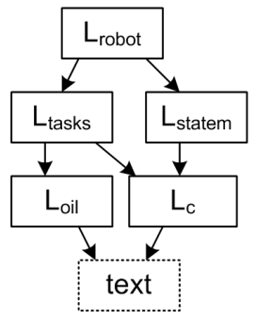
Transformation

Slide 102
Transformation
L_{D}
Transformation
L_{D-1}
Known Semantics!

Slide 103
Transformation
L_{D}
Correct!?
Transformation
L_{D-1}

Slide 104
Transformation
Tests (D)
L_{D}
Transformation
Tests (D-1)
L_{D-1}
Run tests on both levels; all pass.
Coverage Problem!

Slide 105
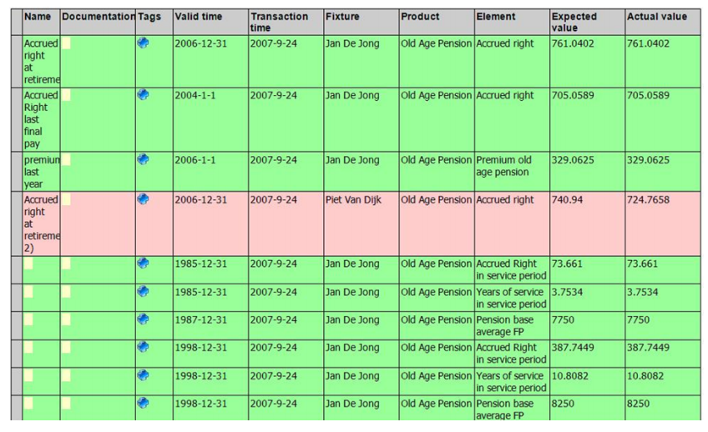
Transformation

Slide 106
Transformation
Tests
Simulators
Documentation
L_{D}
Transformation
L_{D-1}

Slide 107
Multi-Stage
L₃
L₂
Modularization
L₁
L₀

Slide 108
Multi-Stage: Reuse
L₃
L₂
L₅
L₁
Reusing Later Stages
Optimizations!
L₀

Slide 109
Multi-Stage: Reuse
L₃
Reusing Early Stages
Portability
L₂
L₁
L_{1b}
L₀
L_{0b}

Slide 110
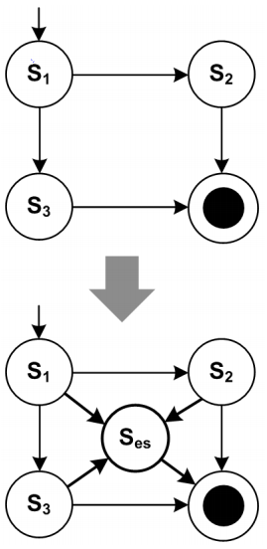
Multi-Stage: Preprocess
Adding an
optional, modular emergency
stop feature

Slide 111
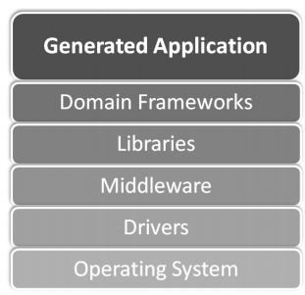
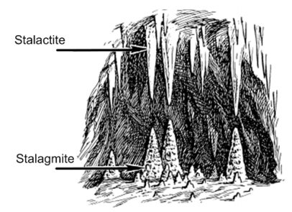
Platform

Slide 112

Interpretation
A program at D₀ that
acts on the structure
of an input program at D_{>0}

Slide 113
Interpretation
A program at D₀ that
acts on the structure
of an input program at D_{>0}
imperative → step through
functional → eval recursively
declarative→ ? solver ?

Slide 114
Transformation
Interpretation

Slide 115
Transformation
Interpretation
+ Code Inspection

Slide 116
Transformation
Interpretation
+ Code Inspection
+ Debugging

Slide 117
Transformation
Interpretation
+ Code Inspection
+ Debugging
+ Performance &
Optimization

Slide 118
Transformation
Interpretation
+ Code Inspection
+ Debugging
+ Performance &
Optimization
+ Platform Con- formance

Slide 119
Transformation
Interpretation
+ Code Inspection
+ Debugging
+ Performance &
Optimization
+ Platform Con- formance
+ Turnaround Time
+ Runtime Change

Slide 120
Def: Semantics
… via mapping to lower level
L_{D}
Transformation
Interpretation
L_{D-1}

Slide 121
Multiple Mappings
… at the same time
L_{D}
Similar Semantics?
L_{x}
L_{y}
L_{z}

Slide 122
Multiple Mappings
… at the same time
L_{D}
T
Similar Semantics?
L_{x}
L_{y}
L_{z}
T
T
T
all green!

Slide 123
Multiple Mappings
… alternatively, selectably
L_{D}
Extend L_{D} to include data that determines transformation
L_{x}
L_{y}
L_{z}

Slide 124
Multiple Mappings
… alternatively, selectably
L_{D}
External Data: - Switches - Annotation Model
L_{x}
L_{y}
L_{z}

Slide 125
Multiple Mappings
… alternatively, selectably
L_{D}
Heuristics: Analyze model to try to decide
L_{x}
L_{y}
L_{z}

Slide 126
Multiple Mappings
… alternatively, selectably
L_{D}
TESTING!
T
L_{x}
L_{y}
L_{z}
T
T
T

Slide 127
Reduced Expressiveness
bad?
maybe.
good?
maybe!
Model Checking
SAT Solving
Exhaustive Search, Proof!

Slide 128
Unique State Names
Unreachable States
Dead End States
Guard Decidability
Reachability
Exhaustive Search, Proof!

Slide 129


Slide 131
Separation of Concerns
expressivity
coverage
semantics
separation of concerns
completeness
paradigms
modularity
concrete syntax
process

Slide 132

Several Concerns
… in one domain

Slide 133

Several Concerns
… in one domain
integrated into
one fragment
separated into
several fragments

Slide 134
Viewpoints
independent
dependent

Slide 135
Viewpoints
independent
sufficient?
contains all
the data for running a meaningful
transformation

Slide 136
Viewpoints
Well-defined Dependencies
No Cycles!
Avoid Synchronization!
(unless you use a projectional editor)

Slide 137
Viewpoints: Why?
Sufficiency
Different Stakeholders
Different Steps in Process – VCS unit!

Slide 138


Viewpoints: Why?
1:n Relationships

Slide 139
Viewpoints: Why?
L_{D}
L_{Annotation}
L_{D-1}

Slide 140

Progressive Refinement

Slide 141

Views on Programs

Slide 143
Completeness
expressivity
coverage
semantics
separation of concerns
completeness
paradigms
modularity
concrete syntax
process

Slide 144
Can you generate 100% of the code from the DSL program?
More generally: all of D₋₁

Slide 145



Semantics:
Introduce G (“generator”):
complete
incomplete

Slide 146
Incomplete: What to do?
F_{D}
OB(F_{D}) !=
F_{D-1}

Slide 147
Incomplete: What to do?
Manually written code!
F_{D}
OB(F_{D}) ==
F_{D-1}
+ F_{D-1, man}

Slide 148
Manually written code?
Call “black box” code (foreign functions)

Slide 149
Manually written code?
Call “black box” code (foreign functions)
Embed L_{D-1} code in L_{D} program

Slide 150
Manually written code?
Call “black box” code (foreign functions)
Embed L_{D-1} code in L_{D} program
Use composition mechanisms of L_{D-1} (inheritance, patterns, aspects, …)

Slide 151
Manually written code?
Call “black box” code (foreign functions)
Embed L_{D-1} code in L_{D} program
Use composition mechanisms of L_{D-1} (inheritance, patterns, aspects, …)
Use protected regions (if you really have to…)

Slide 152
Incomplete: When?
Good for technical DSLs:
Devs write L_{D-1} code
Bad for business DSLs.
Maybe use a L_{D-1} std lib that L_{D} code can call into?

Slide 153
Prevent Breaking Promises!
class B extens BBase {
public void doSomething() {
Registry.get(„A“).someMethod();
}
}

Slide 154
Prevent Breaking Promises!
Better:
Dependency Injection
Static analysis tools

Slide 155
Roundtripping
L_{D}
L’_{D}
L_{D-1}
L’_{D-1}
………

Slide 156
Roundtripping – Don’t!
L_{D}
L’_{D}
Semantic Recovery!
L_{D-1}
L’_{D-1}
………

Slide 158
Fundamental Paradigms
expressivity
coverage
semantics
separation of concerns
completeness
paradigms
modularity
concrete syntax
process

Slide 159
Structure
Modularization, Visibility
Namespaces,
public/private
importing

Slide 160

Structure
Modularization, Visibility

Slide 161
Structure
Modularization, Visibility
Namespaces,
public/private
importing
divide & conquer
reuse
stakeholder integration

Slide 162
Structure
Partitioning (Files)
VCS Unit
Unit of sharing
Unit of IP
!= logical modules
may influence language design

Slide 163
Structure
Partitioning (Files)
change impact
link storage
model organization
tool integration

Slide 164
Structure
Spec vs. Implementation
plug in different Impls
different stakeholders

Slide 165
Structure
Specialization
Liskov substitution P
leaving holes (“abstract”)

Slide 166
Structure
Specialization
Liskov substitution P
leaving holes (“abstract”)
variants (in space)
evolution (over time)

Slide 167
Structure
Superposition, Aspects
merging
overlay
AOP
modularize cross-cuts

Slide 168

Structure
Superposition, Aspects

Slide 169
Behavior
Not all DSLs specify behavior
Some just declare behavior
This section is
not for those!

Slide 170
Behavior
Imperative
sequence of statements
changes program state
write | understand | debug | analyze | performance
simple | simple - | simple (step) | hard | good

Slide 171
Behavior
Functional
functions call other functions.
no state. No aliasing.
write | understand | debug | analyze | performance
simple - | simple | simple (tree) | good | good -

Slide 172

Behavior
Functional

Slide 173
Behavior
Functional
pure expressions are
a subset of functional
(operators hard-wired)
guards
preconditions
derived attributes

Slide 174
Behavior
Declarative
only facts and goals. no control flow.
eval engine, solver (several)
write | understand | debug | analyze | performance
simple | simple - | hard | depends | often bad

Slide 175
Behavior
Declarative
concurrency
constraint programming
solving
logic programming

Slide 176

Behavior
Declarative

Slide 177
Behavior
Reactive
reactions to events, more events are produced. Communication via
events and channels/queues
write | understand | debug | analyze | performance
simple | simple/hard | hard | simple | can be good

Slide 178

Behavior
Reactive

Slide 179

Behavior
Data Flow
chained blocks consume continuous data that flows from block to block
write | understand | debug | analyze | performance
simple - | simple/hard | hard | simple | can be good

Slide 180
Behavior
Data Flow
continuous, calc on change
quantized, calc on new data
time triggered, calc every x

Slide 181
Behavior
Data Flow
Embedded Programming
Enterprise ETL & CEP

Slide 182
Behavior
State Based
states, transitions,
guards, reactions
event driven, timed
write | understand | debug | analyze | performance
simple - | simple/hard | s/h | simple + | can be good

Slide 183

Behavior
Combinations
data flow uses functional, imperative or declarative lang inside block

Slide 184
Behavior
Combinations
state machines use expressions in guards and often an imperative lang in actions

Slide 185

Behavior

Slide 186

Behavior
Combinations
purely structural languages often use expressions to specify constraints

Slide 188
Language Modularity
expressivity
coverage
semantics
separation of concerns
completeness
paradigms
modularity
concrete syntax
process

Slide 189
Language Modularity,
Composition and Reuse (LMR&C)
Behavior
increase efficiency of DSL development

Slide 190
Language Modularity,
Composition and Reuse (LMR&C)
Behavior
increase efficiency of DSL development
4 ways of composition:
Referencing
Reuse
Extension
Reuse

Slide 191
Language Modularity,
Composition and Reuse (LMR&C)
Behavior
increase efficiency of DSL development
4 ways of composition:
distinguished regarding
dependencies and fragment
structure

Slide 192
Dependencies:
Behavior
do we have to know about the reuse when designing the languages?

Slide 193
Dependencies:
Behavior
do we have to know about the reuse when designing the languages?
Fragment Structure:
homogeneous vs. heterogeneous
(„mixing languages“)

Slide 194

Dependencies &
Behavior
Fragment Structure:

Slide 195

Dependencies &
Behavior
Fragment Structure:

Slide 196

Referencing
Referencing

Slide 197
Referencing
Referencing
Dependent
No containment

Slide 198
Referencing
Used in Viewpoints

Slide 199

Referencing

Slide 200
Referencing
Dependent
Containment

Slide 201
Extension
Extension
more specialized domains
more specialized languages

Slide 202
Extension
D_{n+1}
==
D_{n}

Slide 203
Extension
D_{n+1}
==
D_{n}

Slide 204
Extension
Good for bottom-up (inductive) domains, and for use by technical DSLs (people)
==
D_{n}

Slide 205
Extension
Drawbacks
Behavior
tightly bound to base
potentially hard to analyze
the combined program

Slide 206

Extension
Extension

Slide 207

Reuse
Reuse

Slide 208
Reuse
Reuse
Independent
No containment

Slide 209
Reuse
Reuse
Behavior
Often the referenced language is built expecting it will be reused.
Hooks may be added.

Slide 210

Embedding

Slide 211
Embedding
Embedding

Slide 212
Embedding
Independent
Containment

Slide 213
Embedding
Behavior
Embedding often uses Extension to extend the embedded language to adapt it to its new context.

Slide 214
Challenges - Syntax
Behavior
Extension and Embedding requires modular concrete syntax
Many tools/formalisms cannot do that

Slide 215
Challenges – Type Systems
Behavior
Extension: the type system of the base language must be designed to be extensible/ overridable

Slide 216
Challenges – Type Systems
Behavior
Reuse and Embedding: Rules that affect the interplay can reside in the adapter language.

Slide 217

Challenges – Trafo & Gen
Referencing (I)
Behavior
Written specifically for the combination
Can be Reused
Two separate, dependent single-source transformations

Slide 218

Challenges – Trafo & Gen
Referencing (II)
A single multi-sourced transformation

Slide 219

Challenges – Trafo & Gen
Referencing (III)
A preprocessing trafo that changes the referenced frag in a way speciﬁed by the referencing frag

Slide 220

Challenges – Trafo & Gen
Extension
Transformation by assimiliation, i.e.
generating code in the host lang
from code expr in the extension lang.

Slide 221

Challenges – Trafo & Gen
Reuse (I)
Reuse of existing
transformations for both fragments plus generation of adapter code

Slide 222

Challenges – Trafo & Gen
Reuse (II)
composing transformations

Slide 223

Challenges – Trafo & Gen
Reuse (III)
generating separate artifacts plus a weaving specification

Slide 224
Challenges – Trafo & Gen
Embedding (I)
a purely embeddable language may not come with a generator.
Assimilation (as with Extension)

Slide 225

Challenges – Trafo & Gen
Embedding (II)
Adapter language can coordinate the transformations for the host and for the emebedded languages.

Slide 227
Concrete Syntax
expressivity
coverage
semantics
separation of concerns
completeness
paradigms
modularity
concrete syntax
process

Slide 228
UI for the language!
Important for acceptance by users!
Textual
Symbolic
Tabular
Graphical

Slide 229

Reuse existing syntax of domain, if any!
Tools let you freely combine all kinds.

Slide 230
Default: Text
Editors simple to build
Productive
Easy to integrate w/ tools
Easy to evolve programs
… then add other forms,
if really necessary

Slide 231
Default: Text
Editors simple to build
Productive
Easy to integrate w/ tools
Easy to evolve programs

Slide 232

Graphical in case…
Relationships

Slide 233

Graphical in case…
Flow and Depenency

Slide 234

Graphical in case…
Causality and Timing

Slide 235

Symbolic
Either Mathematical, or often highly inspired by domain

Slide 236
Tables

Slide 237

Combinations

Slide 238

Combinations

Slide 239

Combinations

Slide 240

Combinations

Slide 242
Process
expressivity
coverage
semantics
separation of concerns
completeness
paradigms
modularity
concrete syntax
process

Slide 243
Domain Analysis
Interview Experts
Structure their Knowledge
Build the Language
Create Examples
Get Feedback

Slide 244

Iterate to goal

Slide 245
Documentation
Create example-based tutorials!

Slide 246
Domain Folks Programming?
Precision vs.
Algorithmics!

Slide 247
Domain Folks Programming?
DU Coding
DU/Dev Paired
Dev Coding DU Reviewing

Slide 248
DSL as a Product
Release Plan
Bug Tracker
Testing! Support
Documentation

Slide 249
Reviews
Reviews become easier --- less code, more domain-specific

Slide 251
The End.
This material is part of my upcoming (early 2013) book DSL Engineering. Stay in touch, it may become a free eBook ☺
www.voelter.de
voelterblog.blogspot.de
@markusvoelter
+Markus Voelter

